Slide 1
QC BASICS
Asmita Joshi

Slide 2
Brief History
Quantum mechanics came to be proposed in the 1920s .
Key figures like Max Planck, Niels Bohr, Werner Heisenberg, and Erwin Schrödinger
This idea, ultimately led in the early 1980s -Feynman proposing to simulate quantum system and ultimately any physical system on a quantum computer
Deutsch came up with a quantum Church Turing machine, introduced qubits and quantum gates
Deutsch-Jozsa alg
Shor’s factorization-1994
Grover’s search algorithm-1996

Slide 3
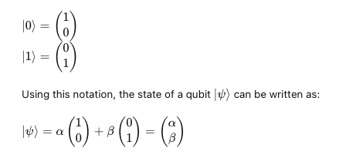
Linear algebra behind QC
Classical particle-single valued, continuous , quantum particle- discrete, random but probabilistic
Vector space: a collection of vectors which can be scaled by multiplying with scalars and adding other vectors.
Dimension of a vector space: the number of basis vectors required to span it
Hilbert space: A vector space of dimension 2^n for n qubits, that has an inner product and is complete, i.e,if you have an infinite sequence of vectors that get closer and closer together, they converge to a vector that is also in the Hilbert space.
Qubits are vectors in a Hilbert space.
Notes:
https://www.youtube.com/watch?v=3nvbBEzfmE8

Slide 4
What is a qubit, Bra-ket notation
Qubit:
fundamental unit of quantum information
Can exist in a state of superposition
Represented in multiple ways: vectors in a hilbert space, wave functions, geometrically through Bloch spheres.
Bra-ket notation:
: Ket- Label for a vector(column vector))
: Bra-vector dual to its ket counterpart. It can also be understood as a linear functional that maps a ket to a complex number( inner product)
Notes:
Reference: https://www.youtube.com/watch?v=lRR-qgjaKlg

Slide 5
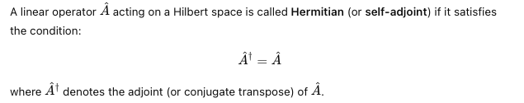
Hermitian operators and observables
Observables: physical quantities that can be measured in a quantum system, such as position, momentum, and energy. Mathematically, observables are represented by Hermitian operators.
The measurements of these observables correspond to the eigenvalues of the operator.
Hamiltonian: A type of hermitian operator that represents the total energy of the quantum system.
When measuring a qubit, you are measuring observables corresponding to physical quantities. Ex:Pauli spin matrices

Slide 6
Measurement
When a quantum system is observed, it collapses into one of its possible states, making the state known.
Superposition is lost as soon as a measurement is done
If this is the case, how are quantum computers any better than classical ones?
Allows quantum computers to represent and explore many possible solutions simultaneously.
Provides a level of parallelism that classical computers cannot achieve.
Uses constructive interference to amplify correct results.
Employs destructive interference to cancel out incorrect results.
Quantum computers are more efficient at solving certain types of problems: Simulation problems, search problems and optimization problems.

Slide 7
How are qubits implemented on hardware?
Superconducting qubits
Trapped ion qubits
Semiconductor qubits
Topological qubits
Photon based etc
Notes:
https://www.youtube.com/watch?v=ihZXl33t8So&t=781s

Slide 8
Ongoing work/research
Quantum hardware
Error correction
Quantum Machine learning
Topological QC
Quantum Communication
Cryptography
Molecular and material Simulation

